Slide 1
Chapter 1: Introduction
Image processing, analysis and machine vision
Dong Sun Park
Monday, March 23, 2020

Slide 2
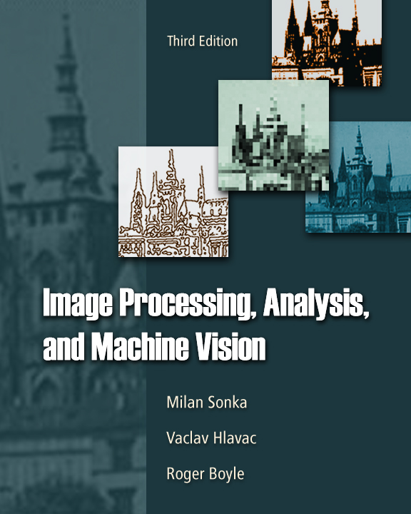
Outline
Motivation
Why is computer vision difficult?
Image representation and image analysis tasks.

Slide 3
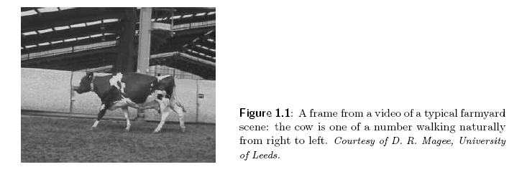
Human vs. machine
How can machine or computer think this image?
Cow shape and boundary from the background.
Some legs are occluded.

Slide 4
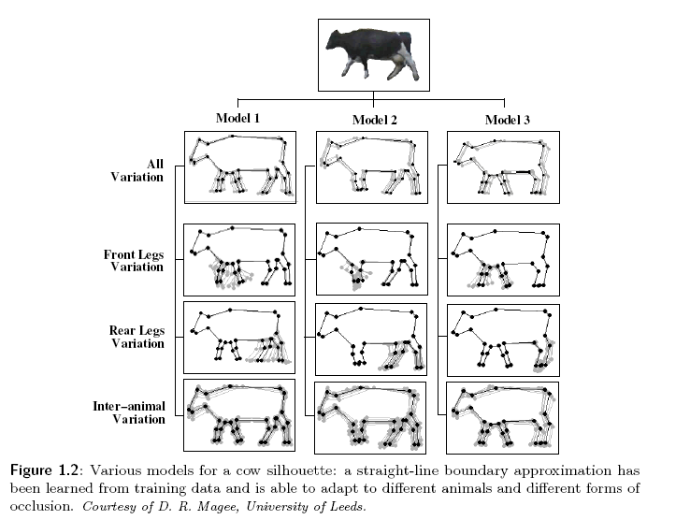
One cow might look like in various poses

Slide 5
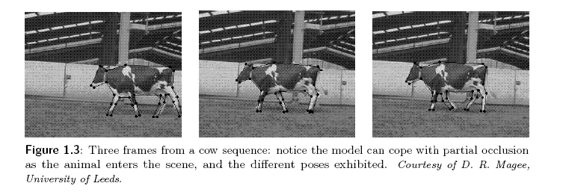
Moving cows could be in different pose.

Slide 6
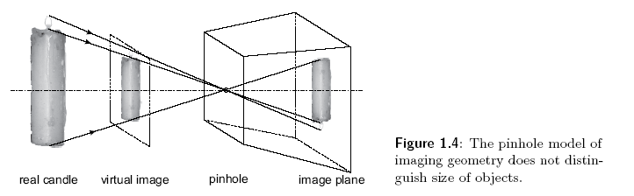
Why is computer vision difficult?
Loss of information when from 3D to 2D

Slide 7
challenges
Interpretation
Human reasoning from knowledge
Machine reasoning from image to model
Traditional rule-based systems; difficulty in generalization
Neural net-based systems
Noise
Random(stochastic) additive noises with distributions
Nonrigid objects
Poses
Views
Inherent variations
Data size
Curse of dimensionality
Illumination

Slide 8
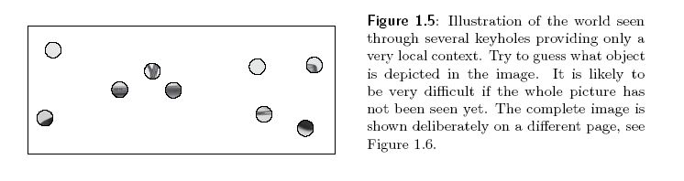
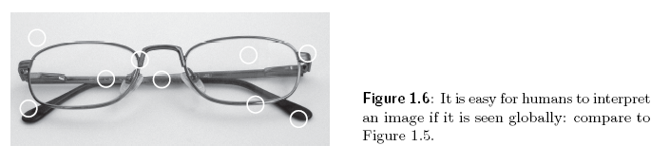
Local and global view.
Can you recognize this?

Slide 9

Can machine recognize these cat?

Slide 10


Other challenges
Interpretation: principal tool of computer vision to approach problems which humans solve unwittingly: $image data→model$
Noise: is inherently present in each measurement in the real world
Too much data: images and video are huge
Object have different poses
Illumination are different.

Slide 11
Image analysis tasks
Machine vision tasks
Object recognition, scene understanding . . .
Mappings into different representations starting from analog images to final interpretations
Four levels in Fig. 1.7
A task or multiple tasks(algorithms) for a mapping
Implementation of Tasks
Bottom-up
From low-level processing with little knowledge to higher levels processings
Top-down
Knowledge on target object or scene
Vision tasks
Low-level image processing
High-level image understanding

Slide 12
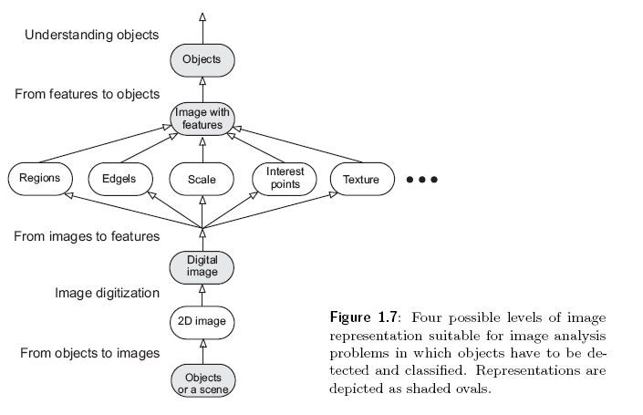
Image representation and image analysis tasks
Two levels
Low: use very little knowledge about the content of the images
High: based on knowledge, goals, and plans of how to achieve those goals and artificial intelligence methods are widely applicable.

Slide 13
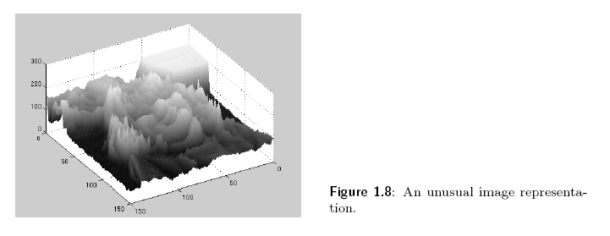
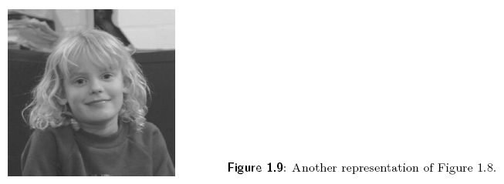
An unusual image representation: the value on the vertical axis gives the brightness of its corresponding location in the right image.

Slide 14
Low-level image processing with original images
Preprocessing or feature extraction
Noise filtering
Contrast enhancement
Edge/boundary extraction with filters
Image compression
High-level computer vision
Segmentation
Object recognition
understanding

Slide 15
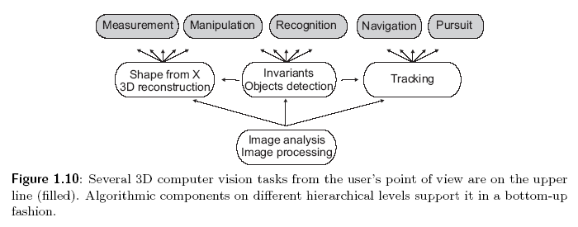
3D vision problems

